Slide 1
INSTALLING & CONFIGURING SERVERS

Slide 2
SELECTING A SERVER

Slide 3
Overview
Installation Methods Installation Types Choosing Whether to Inplace or Migrate Hardware Requirements for Windows Server 2012 R2
Editions
Server licensing
Installing Windows Server 2012

Slide 4
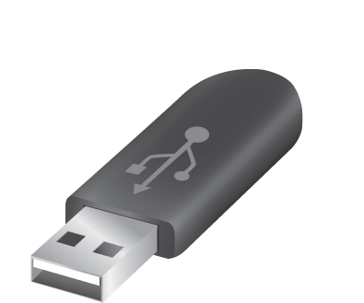
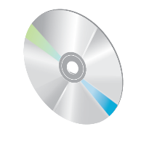
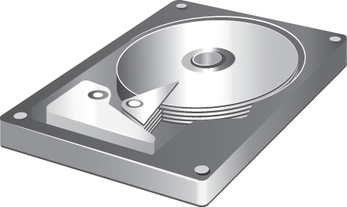
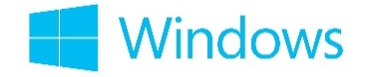

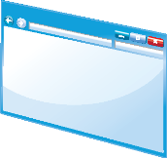

Installation Methods
Windows Server 2012 R2 deployment method options include:
Optical disk
USB flash drive
Windows Deployment Services

Slide 5
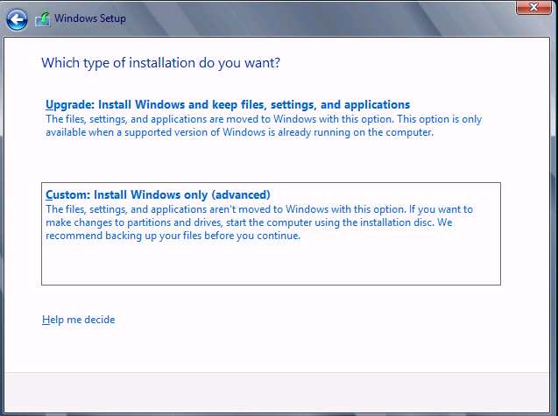
Installation Types

Slide 6


Choosing Whether to Upgrade or Migrate
Migrate
Advantages: | Disadvantages:
Generally straightforward process that takes less time and planning than a migration strategy All server roles, features, data, and application settings are maintained | More difficult to troubleshoot installation failures caused by existing applications or server roles Existing problems and configuration issues might be brought into the new operating system

Slide 7
Choosing Whether to Upgrade or Migrate (Contd.,)
Inplace
Advantages: | Disadvantages:
Easier to troubleshoot installation failures Existing configuration or application issues are not carried forward to the new operating system You can easily move to updated versions of applications | Requires all applications to be reinstalled and configured Requires planning of migration of server roles Requires migration of data Requires the purchase of new hardware

Slide 8
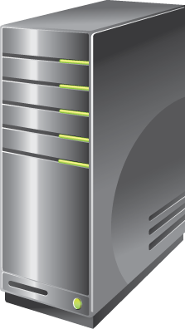
Hardware Requirements for Windows Server 2012 R2
Windows Server 2012 R2 has the following minimum hardware requirements:
Processor architecture x64
Processor speed 1.4 GHz
Memory (RAM) 512 MB
Hard disk drive space 32 GB
More hard disk drive space is needed if the server has more than 16 GB of RAM

Slide 9
EDITIONS
EDITION | IDEAL FOR | FEATURE | LICENSING MODEL | MEMORY LIMITS
FOUNDATION | Cost-efficient all round server | Essential server functionality without virtualization rights | Server (Limited to 15 users) | 32 GB RAM
ESSENTIALS | Environments in small companies | Essential server functionality without virtualization rights | Server (Limited to 25 users) | 64 GB RAM
STANDARD | Non-virtualized or lightly virtualized environments | All features, with two virtual instances | Processor + CAL* | 4 TB RAM
DATACENTER | Highly-virtualized private cloud environments | All features, with unlimited virtual instances | Processor + CAL* | 4 TB RAM
Notes:
(*) CALs are required for each user or device, who directly or indirectly accesses a server. Find more information on this topic at the Client Access Licensessite at microsoft.com.

Slide 10
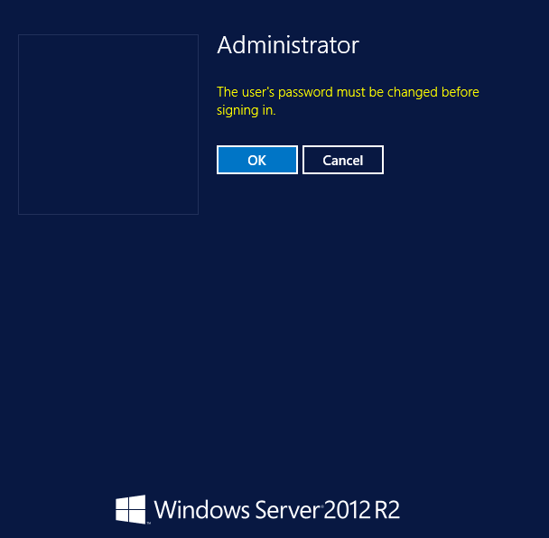
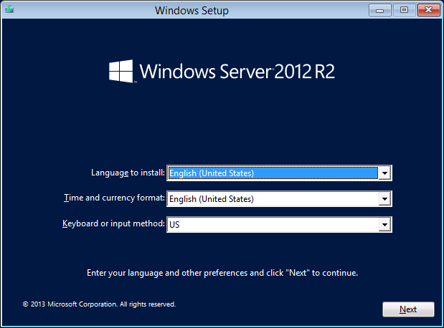
Installing Windows Server 2012

Slide 11
SERVER LICENSING
The packaging and licensing structure for Windows Server 2012 R2 editions remain unchanged.
Datacenter and Standard editions provide:
Differentiation only by virtualization rights: Two virtual instances for Standard edition and unlimited virtual instances for Datacenter edition.
A consistent processor-based licensing model that covers up to two physical processors on a server.
Essentials and Foundation editions provide:
A server-based licensing model: Foundation is for single processor servers and Essentials is for either one or two processor servers.
CALs not required for access: Foundation comes with 15 user accounts and Essentials comes with 25 user accounts.

Slide 12
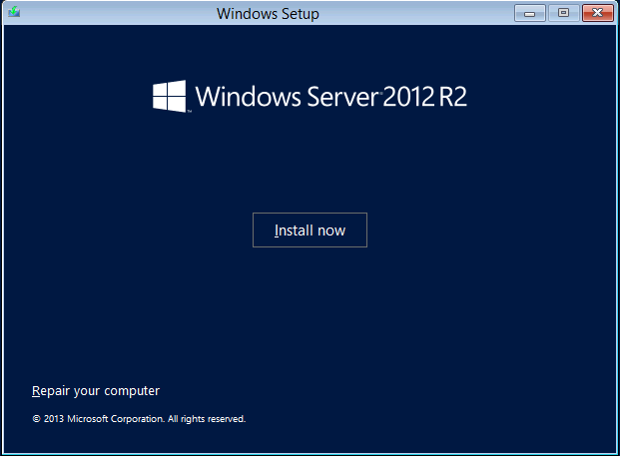
Installing Windows Server 2012 (Contd.,)

Slide 13
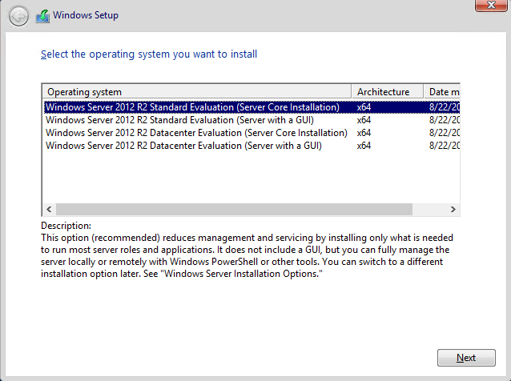
Installing Windows Server 2012 (Contd.,)

Slide 14
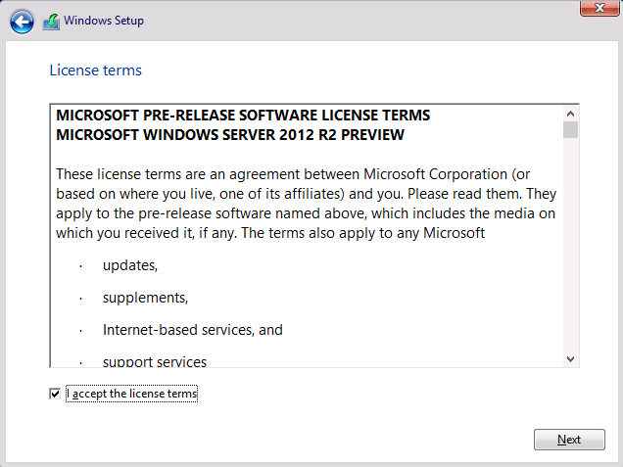
Installing Windows Server 2012 (Contd.,)

Slide 15
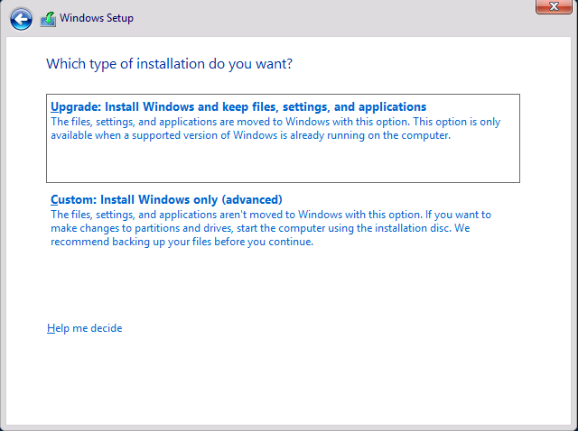
Installing Windows Server 2012 (Contd.,)

Slide 16
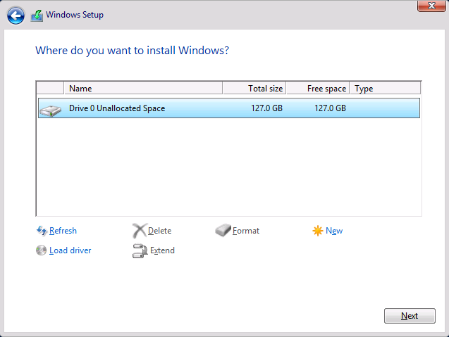
Installing Windows Server 2012 (Contd.,)

Slide 17
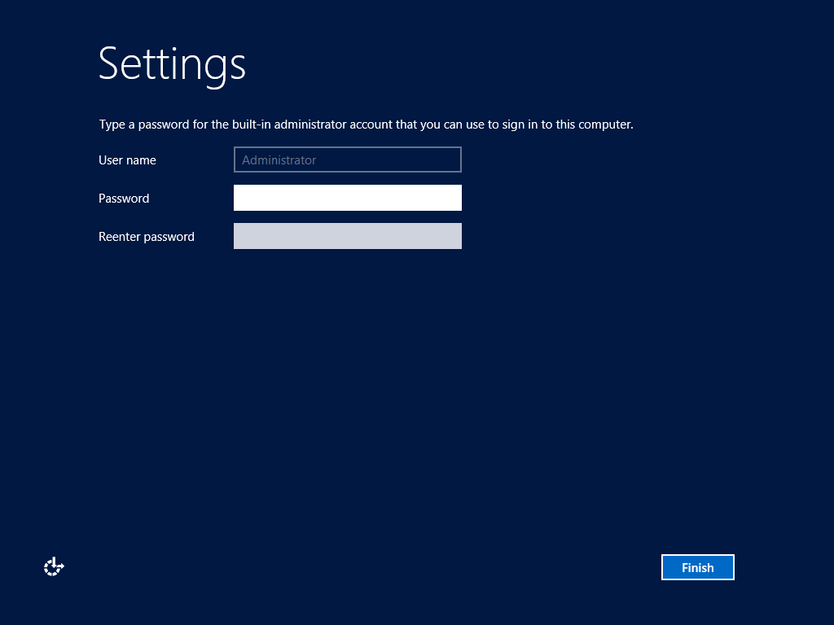
Installing Windows Server 2012 (Contd.,)

Slide 18
Thank you

